Slide 1
Introduction to Computer Graphics

Slide 2
Contents
Improved reality in computer graphics
Graphics pipeline overview
Application

Slide 3
Improved Reality in Computer Graphics

Slide 4
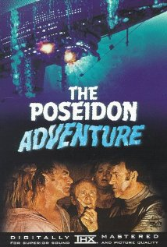
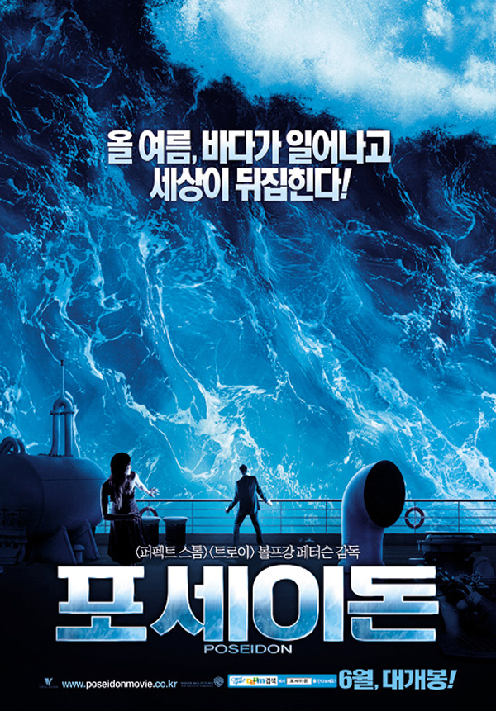
…invite Poseidon 1972 and Poseidon remake 2006

Slide 5
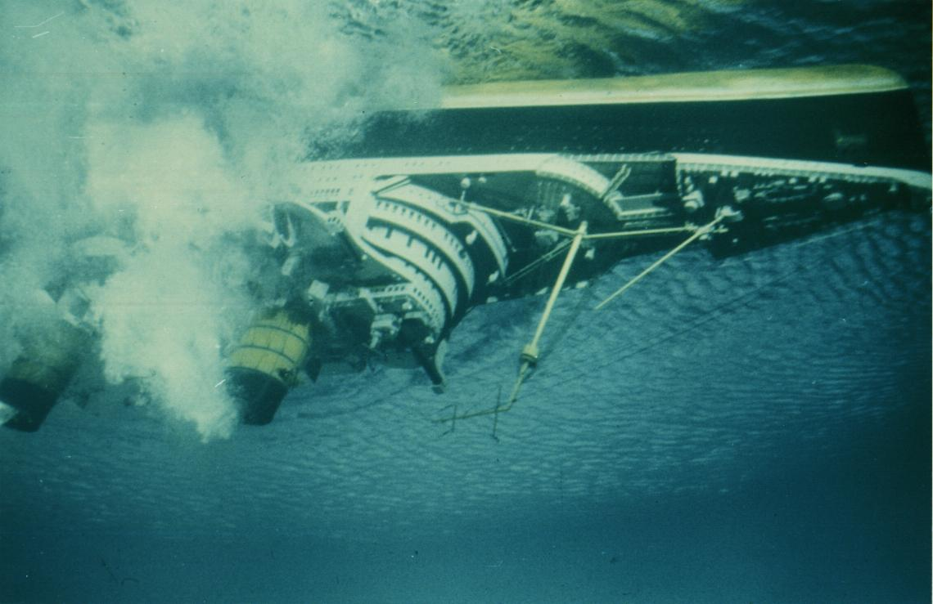
…invite Poseidon 1972 and Poseidon remake 2006

Slide 6
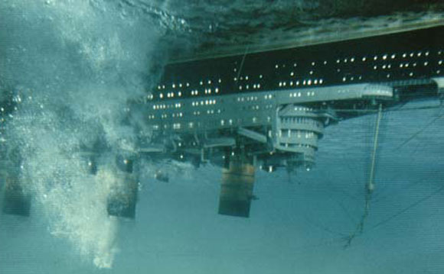
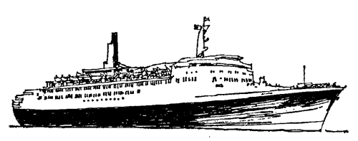
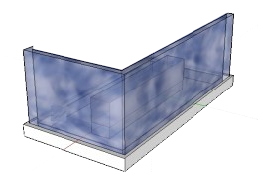
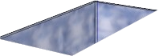
POSE
I
DON1
… Sinking ship…
Notes:
How doodles have helped me listen in new ways…

Slide 7
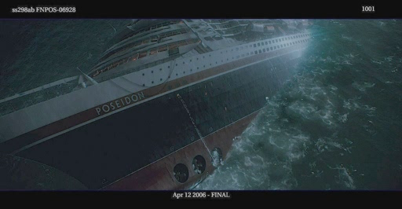
Movie ‘Poseidon’ by ILM 2006
POSE
I
DON

Slide 8
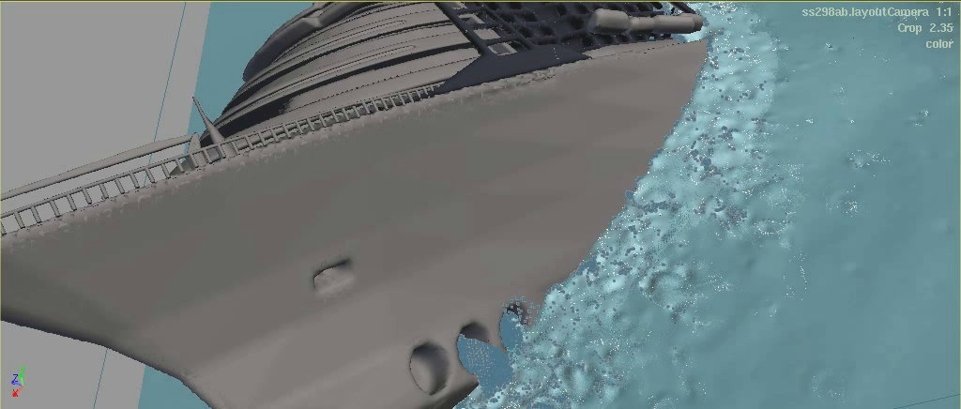
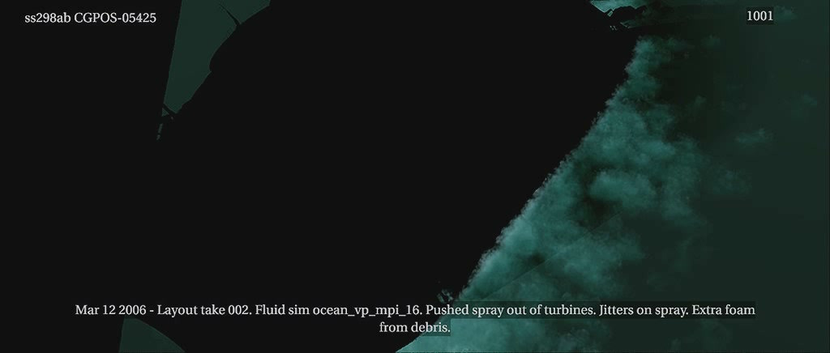
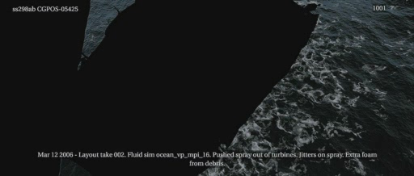
Movie ‘Poseidon’ by ILM 2006
<Layer 1 : Object and Water Surface>
<Layer 2 : Underwater with Bubbles>
<Layer 3 : Splash & Foam>
<Final Composition>

Slide 9
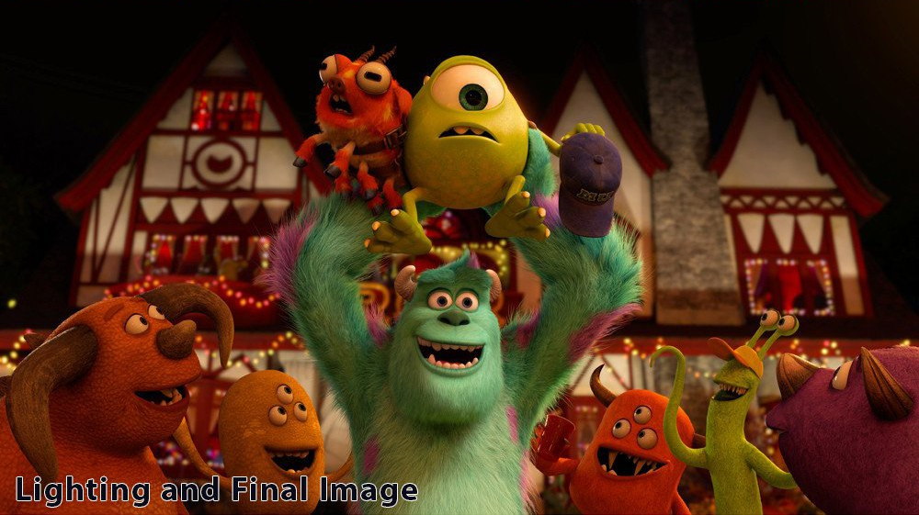
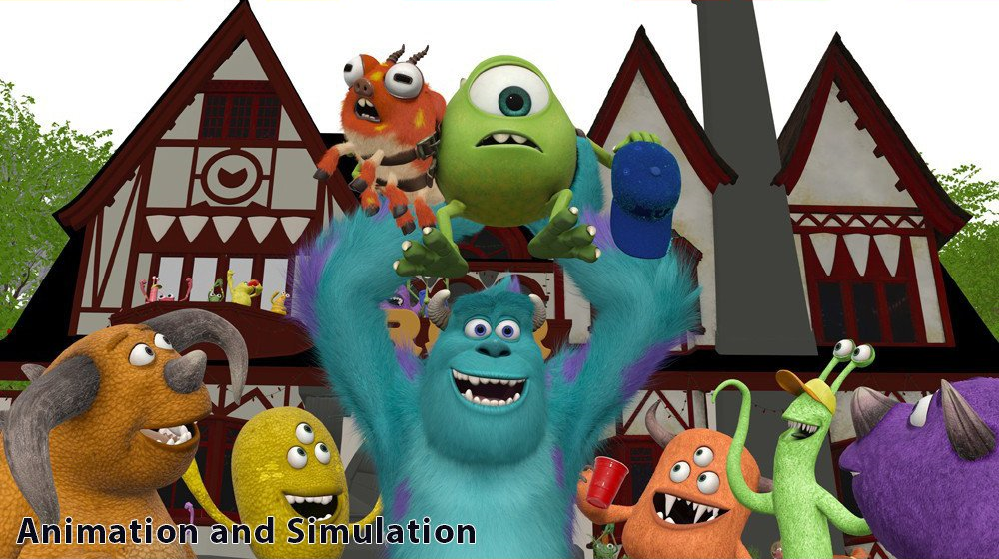
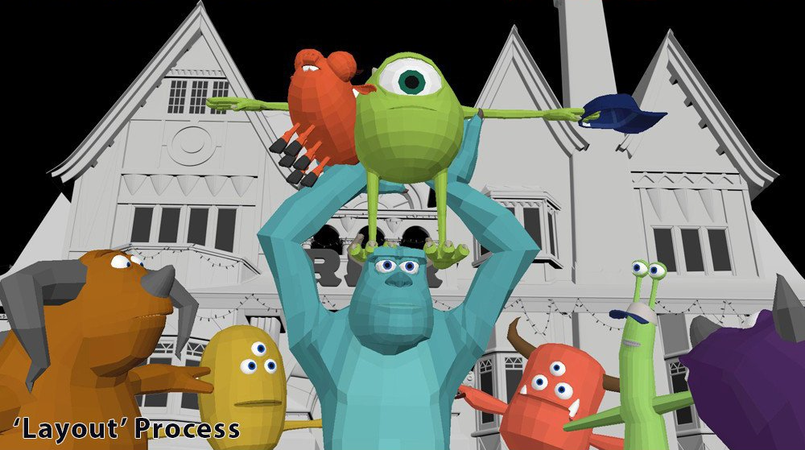
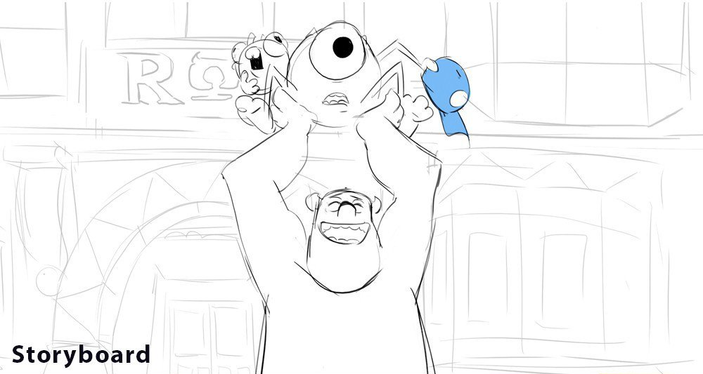
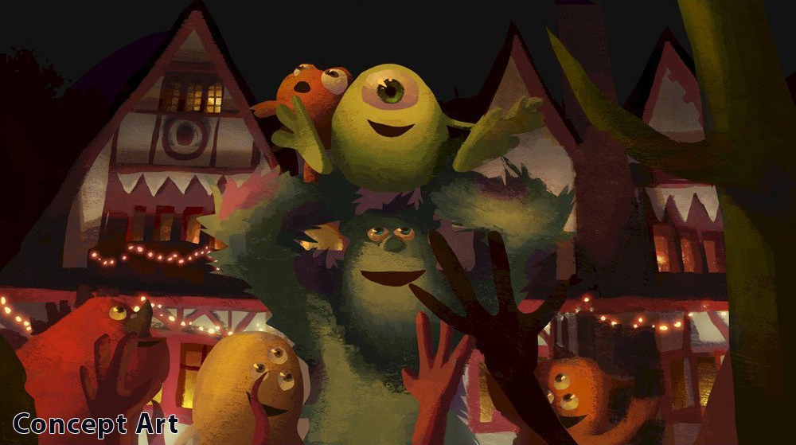
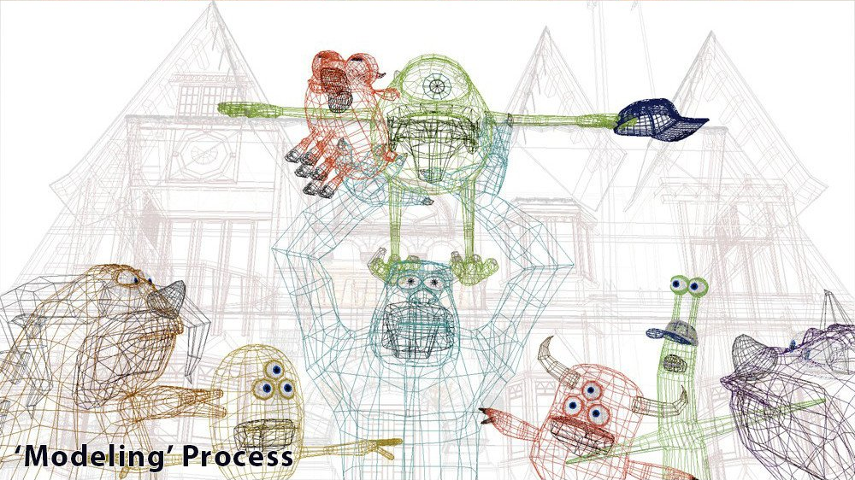
Production of 3D Animation
[Monsters University, 2013]

Slide 10
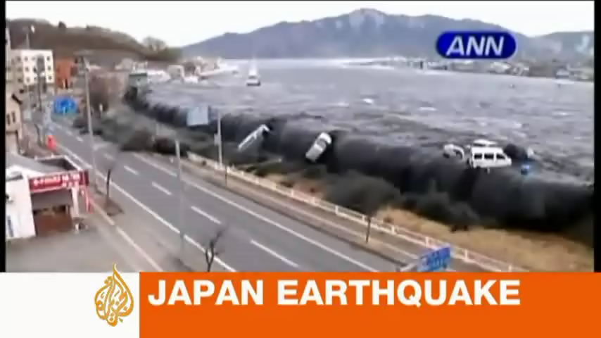
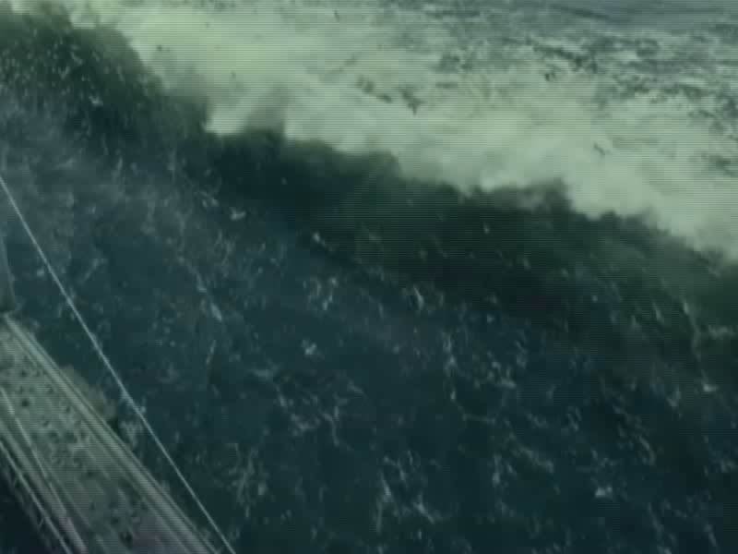
….… Real World vs. Fake World
<영화 ‘해운대’>
<실제 일본 쓰나미, 2011>

Slide 11
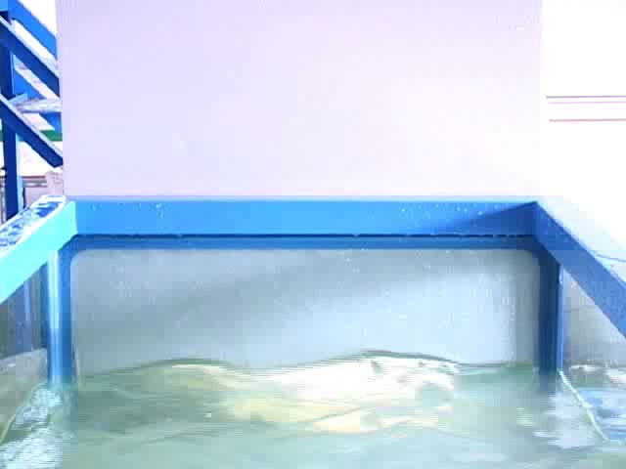
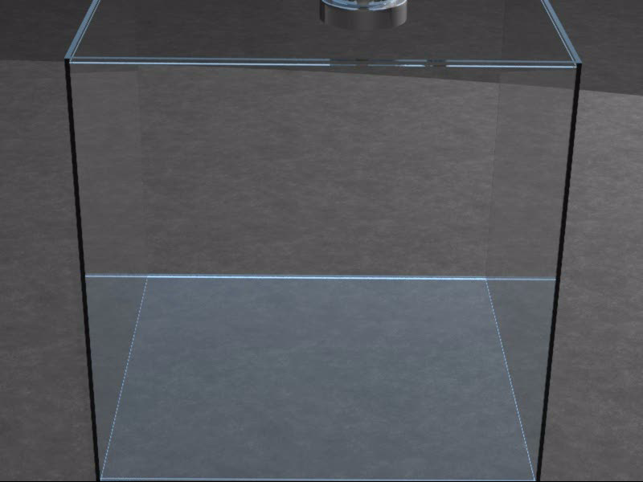
Visual Simulation of Water
Real World ≈ Fake World
Stanford Univ., ACM SIGGRAPH 2010
<Real Water>
<Virtual Water>

Slide 12
Graphics Pipeline Overview

Slide 13
Graphics Pipeline
3D
Geometric
Models
Image
Storage &
Display
Rendering
3D
Animation
Definition
Image &
Texture

Slide 14
Geometric Modeling
3D Scanning
3D Modeling Tool
3D
Geometric
Models
Rendering
Modeling
Libraries

Slide 15
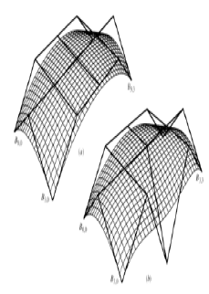
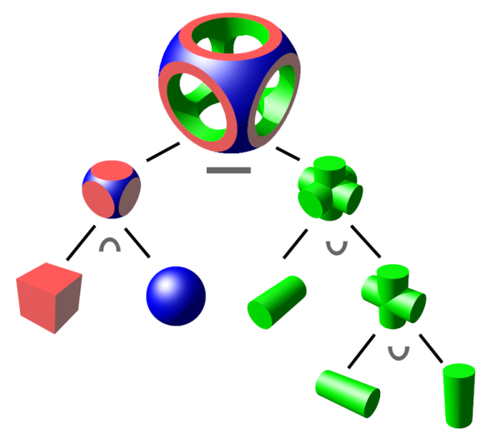
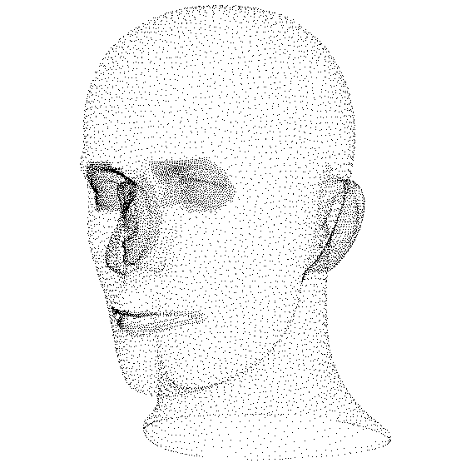
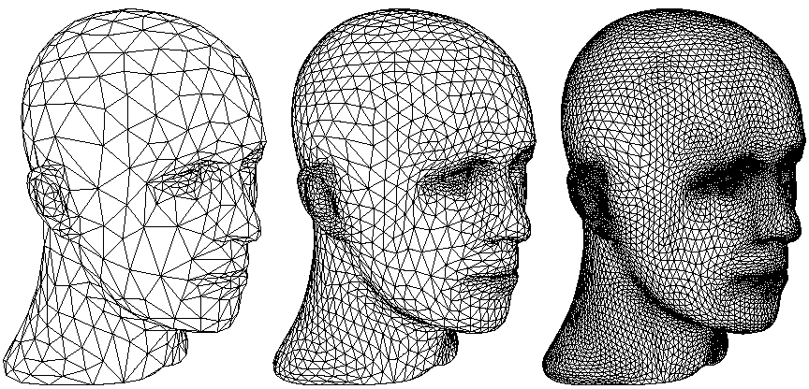
Geometric Modeling Techniques
[Curved Surface]
[Constructive Solid Geometry]
[Scanned Point Cloud]
[Subdivision Surface]

Slide 16
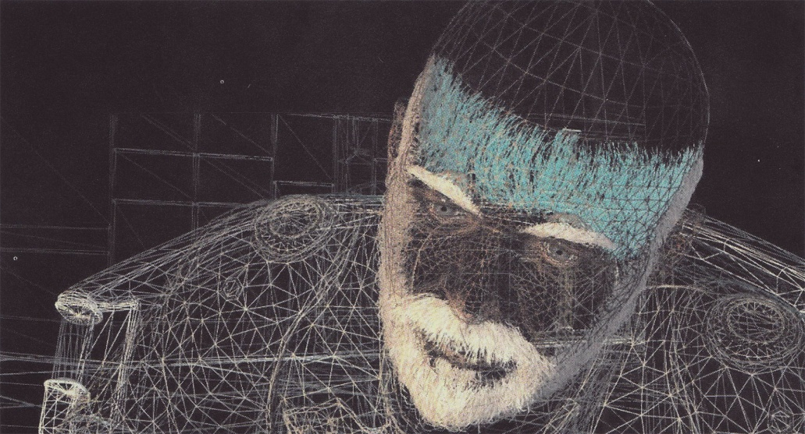
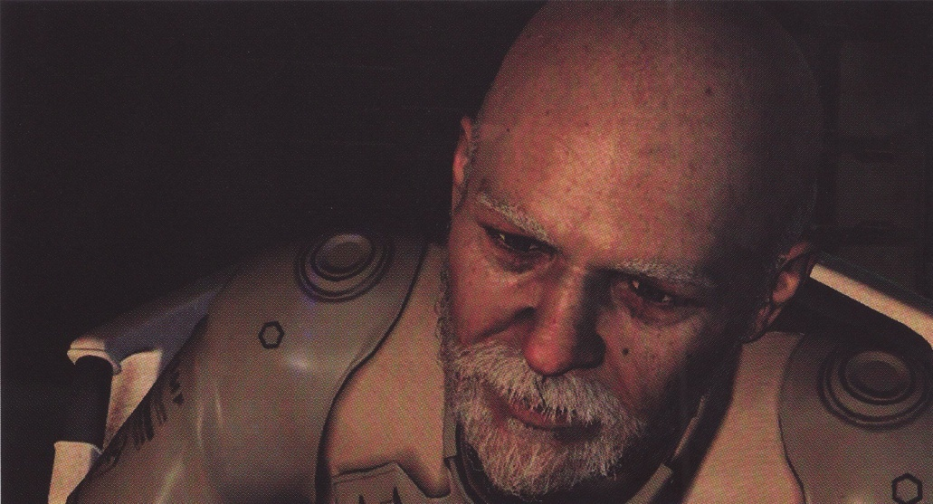
Practical Modeling Example
[Final Fantasy : The Spirits Within, 2001]

Slide 17
3D Animation
Motion Design
Physically Based Simulation
3D
Animation
Rendering
Motion Capture
Dynamic
Deformation

Slide 18
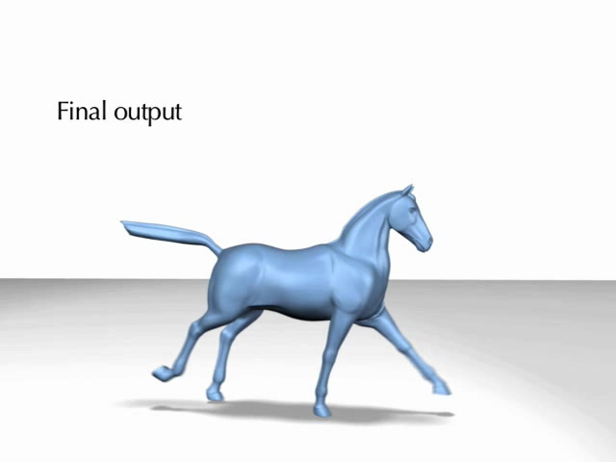
3D Animation Example
[Embedded Deformation for Shape Manipulation] (Robert W. Summer et al., SIGGRAPH 2007)

Slide 19
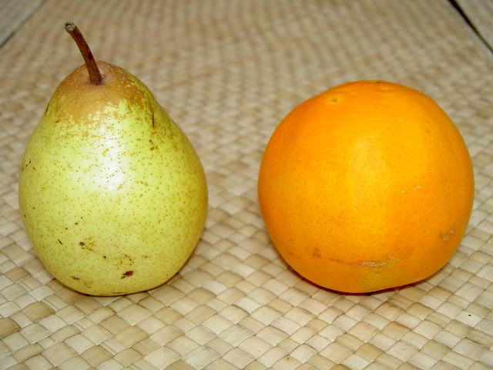
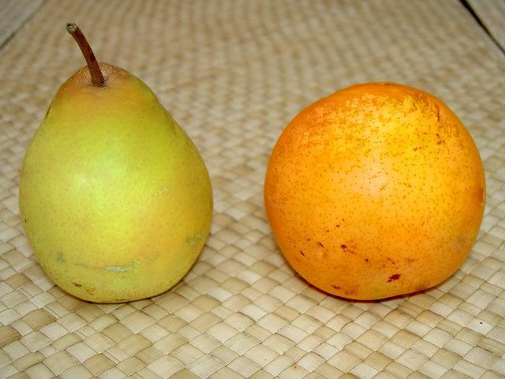
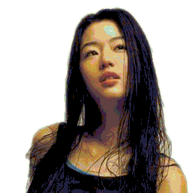
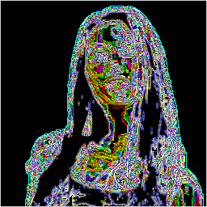
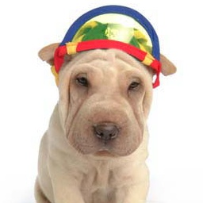

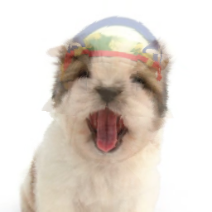

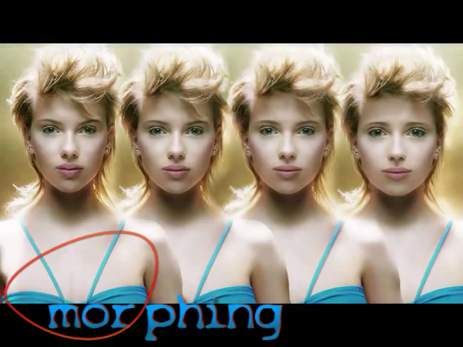
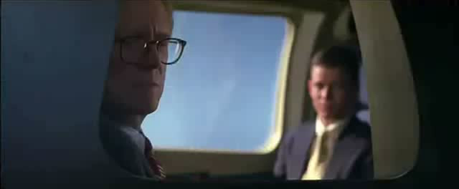
Imaging
[Image Modification]
[Image Filtering]
[Morphing]

Slide 20
Texturing
Scanned Images
Captured
Images
Texture
Information
Rendering
Painted Images

Slide 21
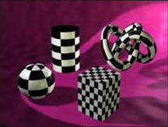
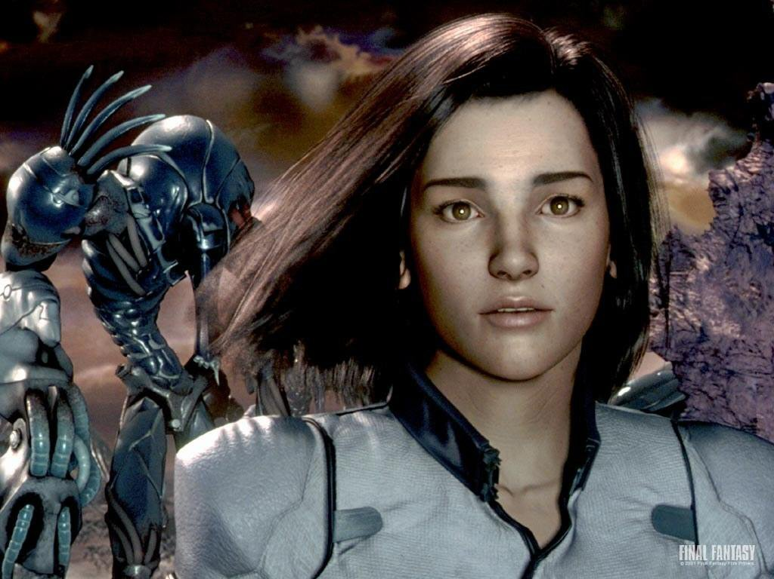
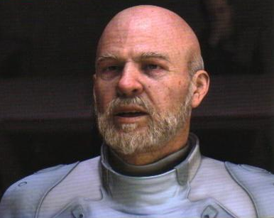
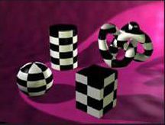
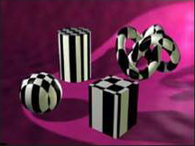
Texturing Examples
[Final Fantasy : The Spirits within, 2001]

Slide 22
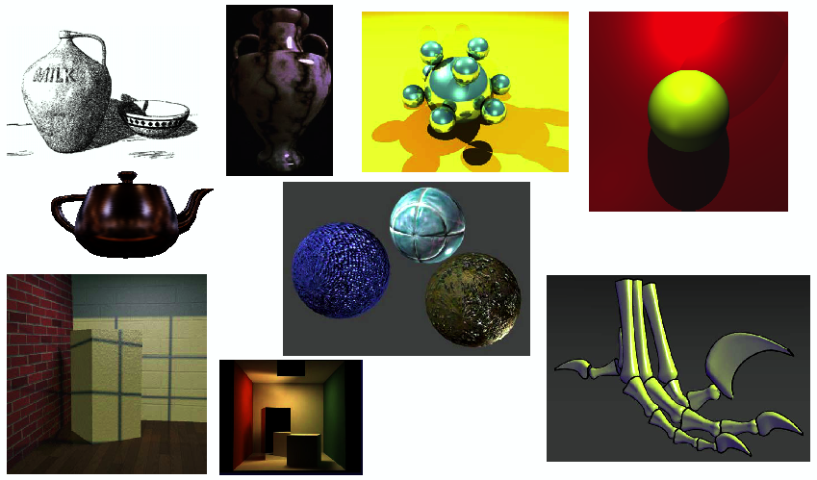
Rendering
Simulating lights & surface reflection

Slide 23
Application

Slide 24
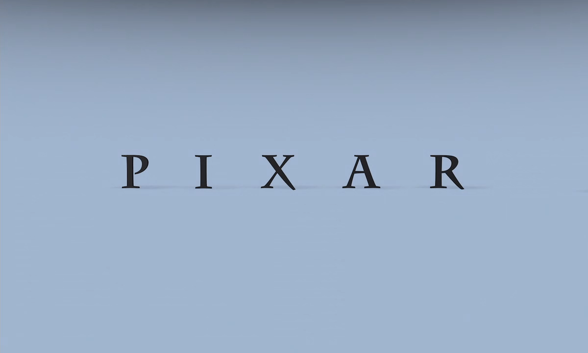
Application: The Trigger to the Era of 3D Animations
[Geri’s game, 1997]

Slide 25
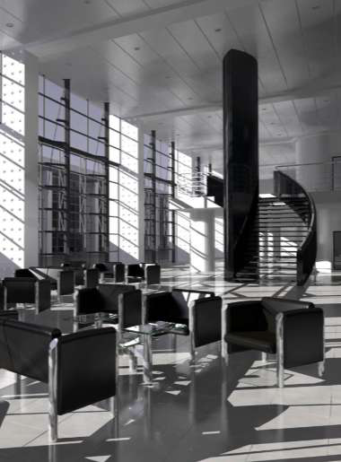
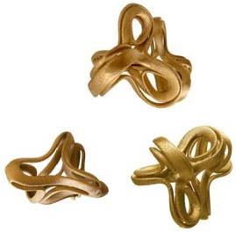
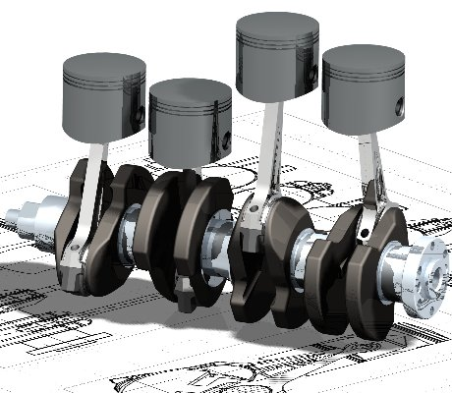
Application: Computer Aided Design(CAD)
For engineering and architectural system
Design of building, automobile, aircraft, etc.
[Architectural Design]
[Computer Aided Sculpture]
[Mechanical Parts Design]

Slide 26
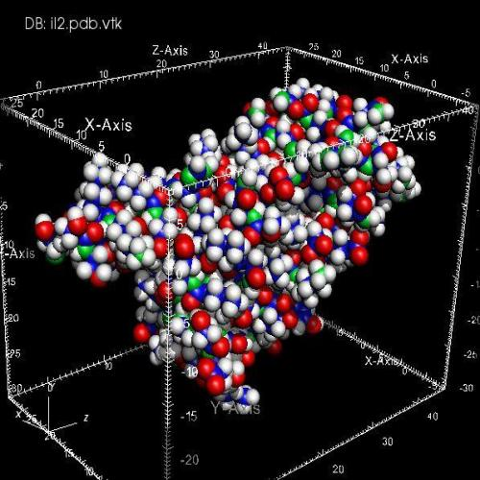
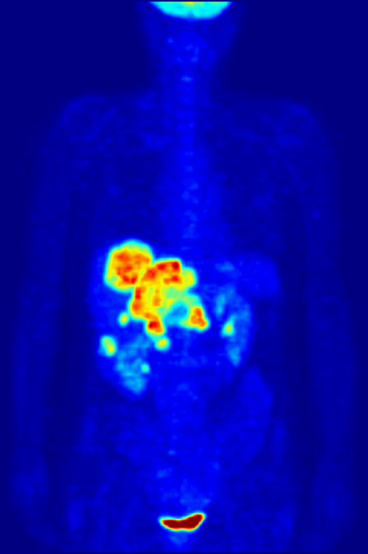
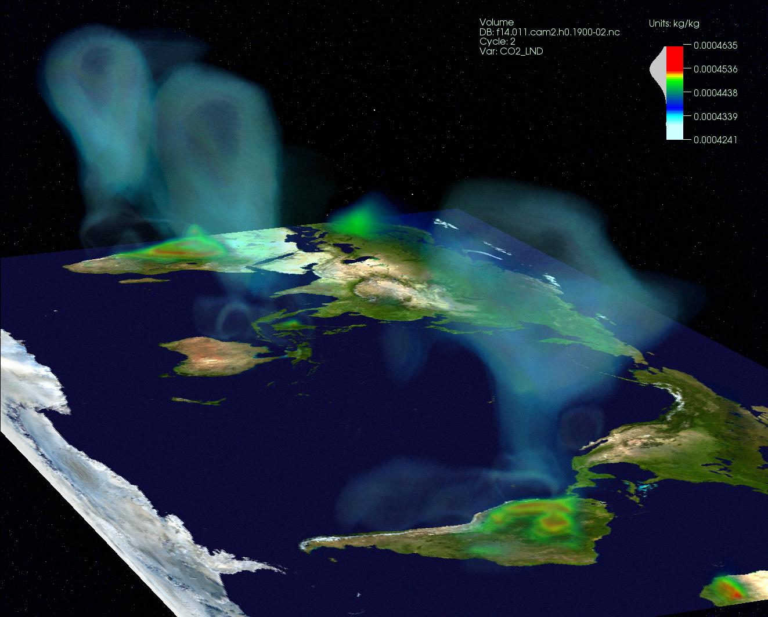
Application: Scientific Visualization
For scientific, engineering, and medical data
[Molecular]
[Medical Image]
[Climate Visualization]

Slide 27
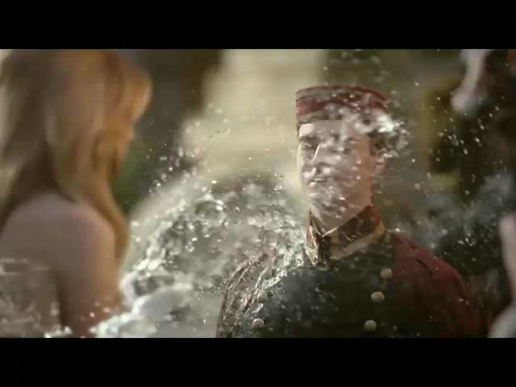
Application: CF and Special Effects
[Mattoni Spring Water: Water Dress, 2008]

Slide 28

Application: TV Drama
[Game of Thrones, 2014]

Slide 29

Application: Fluid Simulation in Movie
[The Last Airbender, 2010]

Slide 30

Application: Explosion & Fracture Simulation in Movie
[Inception, 2010]

Slide 31

Application: Hair Simulation in Movie
[Tangled, 2011]

Slide 32

Application: Ice & Snow Simulation in Movie
[Frozen, 2013]

Slide 33

Application: Game
[Elder Scrolls V: Skyrim, 2011]

Slide 34

Application: Innovative UI
[Ripple Effect]

Slide 35


Application: Augmented Reality
[Oculus Rift]
[Oculus Rift + Omni]

